Slide 1
Coffee
The present market

Slide 2
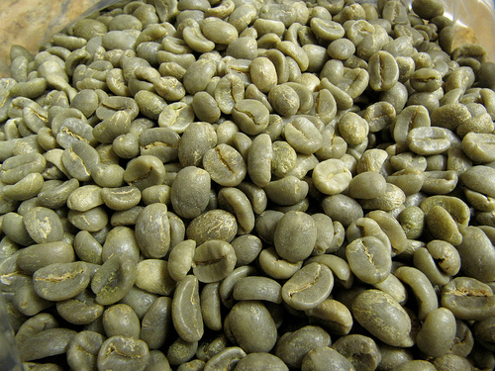
Green coffee beans
History
According to popular legend, the coffee plant was discovered in Ethiopia by a goatherd named Kaldi.
Significant dates
The first coffee plant was found in the mountains of Yemen. Then by 1500, it was exported to the rest of the world through the port of Mokha in Yemen.
First cultivation in India (Chikmagalur) – 1600
First cultivation in Europe (also first cultivation outside of east Africa/Arabia) – 1616
First cultivation in Java – 1699
First cultivation in Caribbean (Cuba, Hispaniola (Haiti and the Dominican Republic), Jamaica, Puerto Rico) – 1715–1730
First cultivation in South America – 1730
First cultivation in Dutch East Indies – 1720
The plants were first introduced in the Americas around 1723.
Roasted beans first sold on retail market (Pittsburgh) – 1865
Important spray-drying techniques developed in 1950s

Slide 3
South America is now responsible for about 45% of the world's total coffee exports. Most of this coffee is grown in Brazil.
The United States imports more coffee than any other nation. The per capita consumption of coffee in the United States in 2011 was 4.24 kg (9 lbs), and the value of coffee imported exceeded $8 billion. As of 2015, Americans consumed approximately 400 million cups of coffee per day, making the United States the leading consumer of coffee in the world.
Global Green Coffee Market: Prominent Market Players
Global Green Coffee Market is emerging concept in sector of Foods and Beverages Industry; many new players are entering in the market. Some prominent players present in today's global green coffee market are Peet's Coffee and Tea, Starbucks Corporation, Keurig Green Mountain Inc, Nestle, P & G, Tchibo and Louis Drefyus Company, among others.
Market Research Future introduces about the global green coffee market during the forecast period 2017-2027 which mainly includes the growth drivers, trends and restraints and how the market will grow in the future across the globe. In this report, Market Research Future has focused on the current market scenario which includes market segmentation, market dynamics, and competitive landscape along with company profiles.

Slide 4

Roasted coffee beans
Roasting coffee transforms the chemical and physical properties of green coffee beans into roasted coffee products. The roasting process is what produces the characteristic flavor of coffee by causing the green coffee beans to change in taste. Unroasted beans contain similar if not higher levels of acids, protein, sugars, and caffeine as those that have been roasted, but lack the taste of roasted coffee beans due to the Maillard and other chemical reactions that occur during roasting.
The vast majority of coffee is roasted commercially on a large scale, but small-scale commercial roasting has grown significantly with the trend toward "single-origin" coffees served at specialty shops. Some coffee drinkers even roast coffee at home as a hobby in order to both experiment with the flavor profile of the beans and ensure the freshest possible roast.
Packing: we deliver 1kg,2kg,5kg,10kg,25,kg

Slide 5
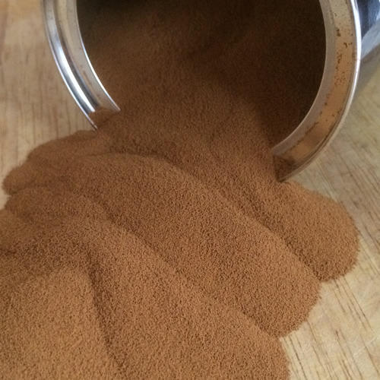
Instant coffee – spray dried
Spray Dried Instant Coffee is produced using unique blend of
carefully selected green coffee beans.
These beans are roasted to the desired roasting parameters before extraction of clear liquid.
The liquid is further processed to evaporate the water through
various stages after removing all non soluble content and then
sprayed into a tall tower to make soluble coffee powder.
The process is completely controlled to keep all the quality aroma
volatiles intact in the final product and to guarantee refreshing
taste in every sip.
The total market for soluble(Instant) coffee is showing signs of strong growth after being relatively flat throughout the decade of the 1990’s. Estimated consumption in countries that do not produce coffee was 22.4 million bags GBE in 2009, of which 28% was manufactured in producing countries.
Packing: Each Carton box consist of 25 kgs of coffee with double poly cover with goose neck.

Slide 6
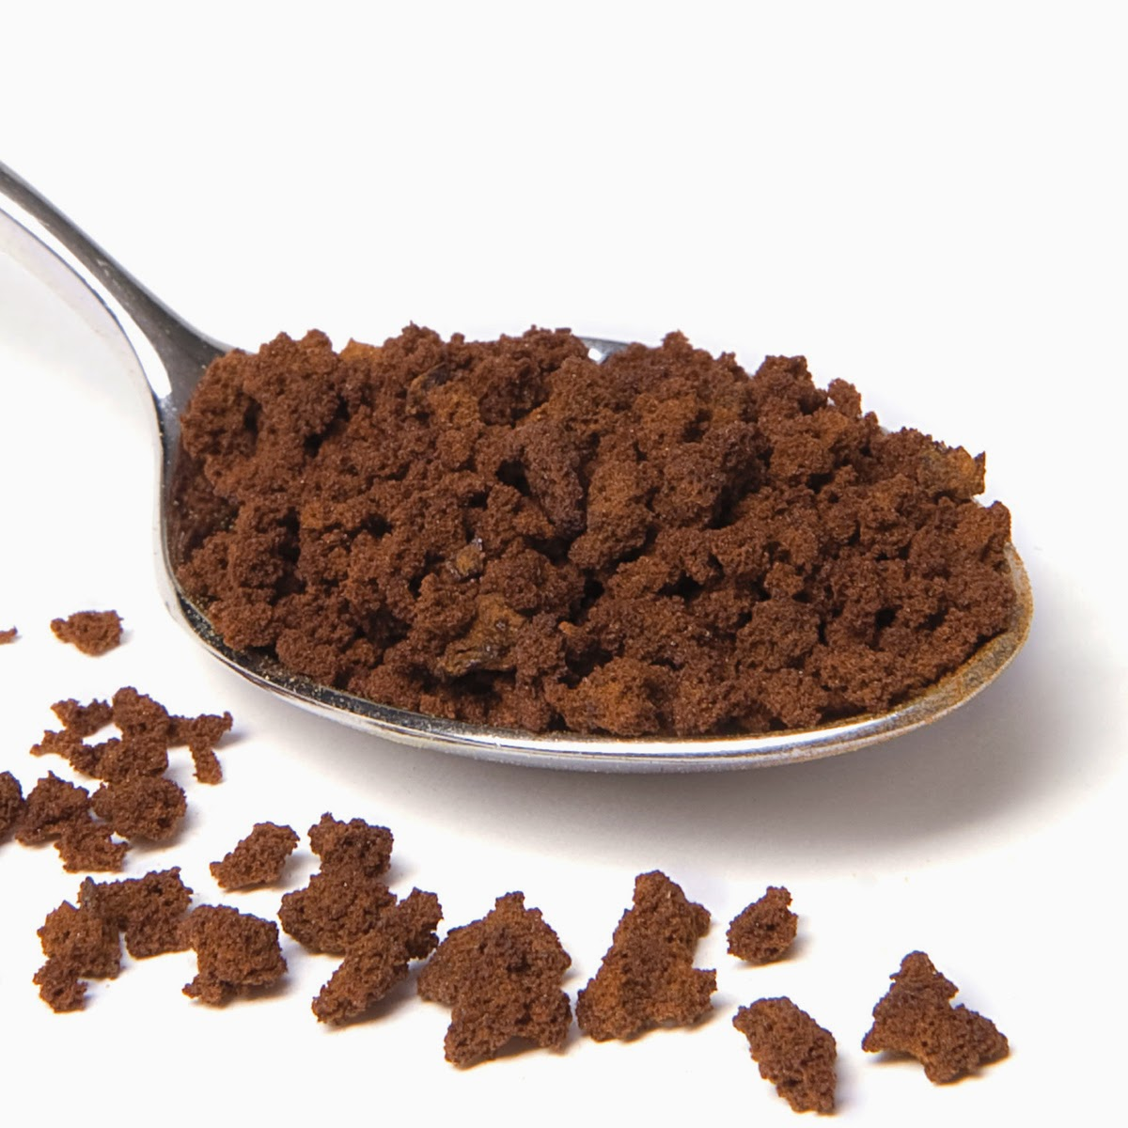
Instant coffee - agglomerated
Agglomerated Instant Coffee is produced using unique blend of
carefully selected green coffee beans.
These beans are
roasted to the desired roasting parameters before extraction
of clear liquid.
The liquid is further processed to evaporate the
water through various stages after removing all non soluble
content and then sprayed into a tall tower to make soluble
coffee powder.
This powder is further processed with steam
to form nice granules which will reduce fines in the product.
The process is completely controlled to keep all the quality
aroma volatiles intact in the final product and to guarantee
refreshing taste in every sip.
The total market for soluble(Instant) coffee is showing signs of strong growth after being relatively flat throughout the decade of the 1990’s. Estimated consumption in countries that do not produce coffee was 22.4 million bags GBE in 2009, of which 28% was manufactured in producing countries.
Packing: Each Carton box consist of 22 kgs of coffee with double poly cover with goose neck.

Slide 7
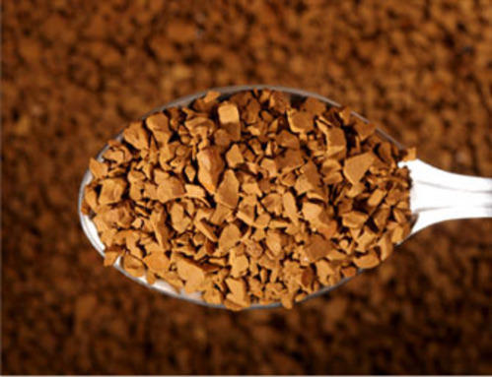
Instant coffee – freeze dried
There are four stages in the complete drying process: pretreatment, freezing, primary drying, and secondary drying.
Freeze Drying is a dehydration process typically used to preserve a perishable material or make the material more convenient for transport.
Freeze-drying works by freezing the material and then reducing the surrounding pressure to allow the frozen water in the material to sublimate directly from the solid phase to the gas phase.
The total market for soluble(Instant) coffee is showing signs of strong growth after being relatively flat throughout the decade of the 1990’s. Estimated consumption in countries that do not produce coffee was 22.4 million bags GBE in 2009, of which 28% was manufactured in producing countries.
Packing: Each Carton box consist of 22 kgs of coffee with double poly cover with goose neck.

Slide 8
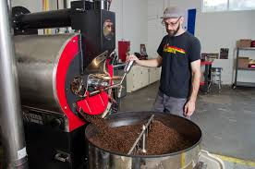


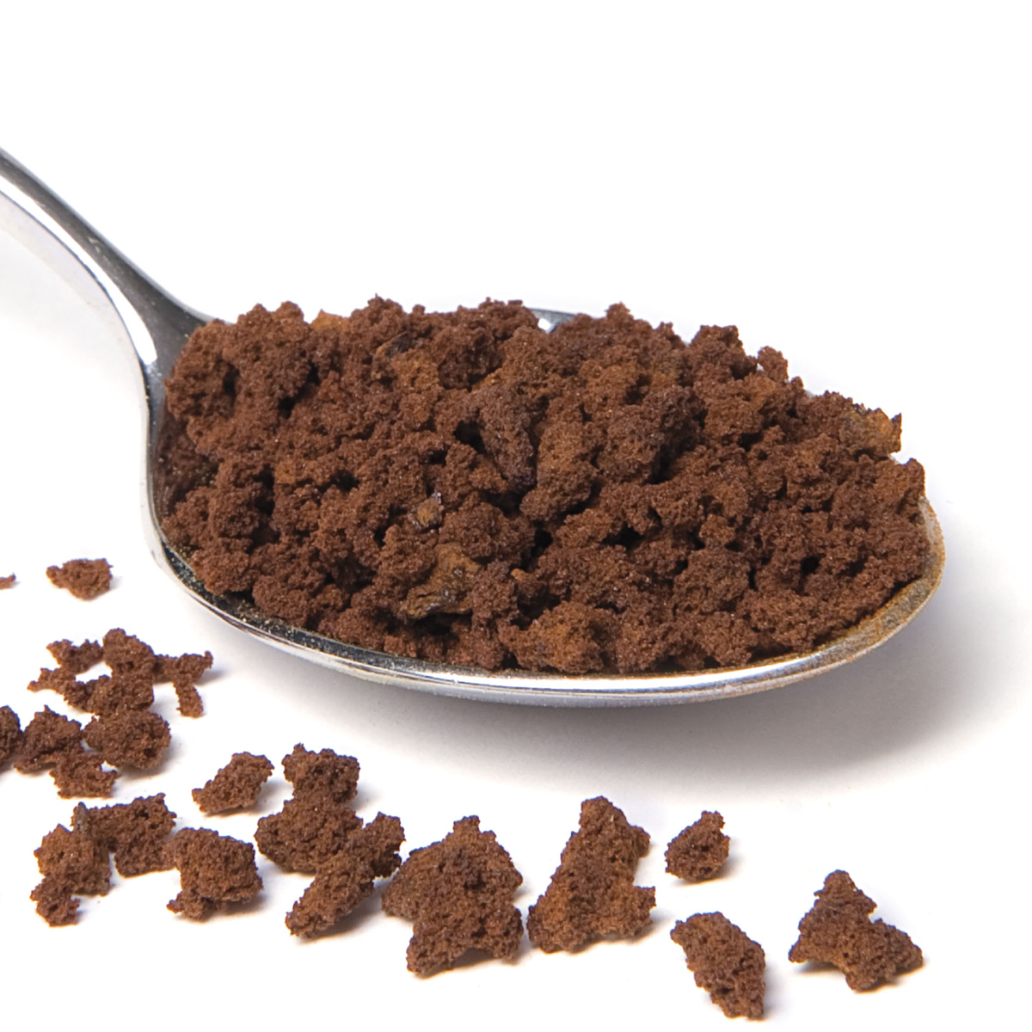
The reports also covers brief analysis of Geographical Region includes:
Americas
North America
  US
  Canada
The Middle East & Africa
Middle East
  Saudi
  Qatar
  UAE
  Rest of Middle East
Africa
  South Africa
  Rest of Africa
Latin America
  Argentina
  Brazil
  Mexico
  Rest of LATAM
Europe
Western Europe
  Germany
  France
  Italy
  Spain
  U.K
  Rest of Western Europe
Eastern Europe
  Poland
  Russia
Asia – Pacific
Asia
  China
  India
  Japan
  South Korea
  Rest of Asia
Pacific Countries
  Australia
  New Zealand

Slide 9
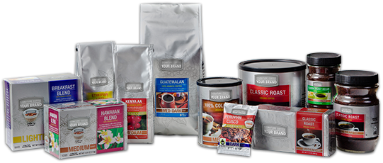
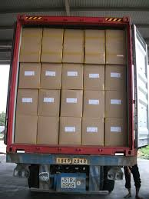
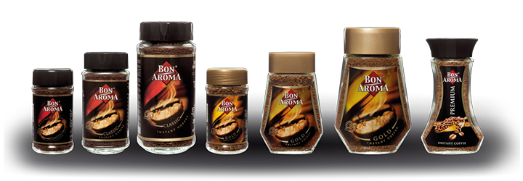
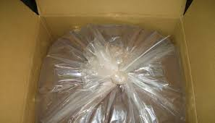

PRIVATE LABELS
BULK PACKS | CONSUMER PACKS | CONSUMER PACKS
CARTONS | METAL CANS | POUCHES
22 KS TO 25 KGS | Various sizes-Private Label | Various sizes-Private Label Packaging
We provide private label along with packing as per buyers requirements

Slide 10
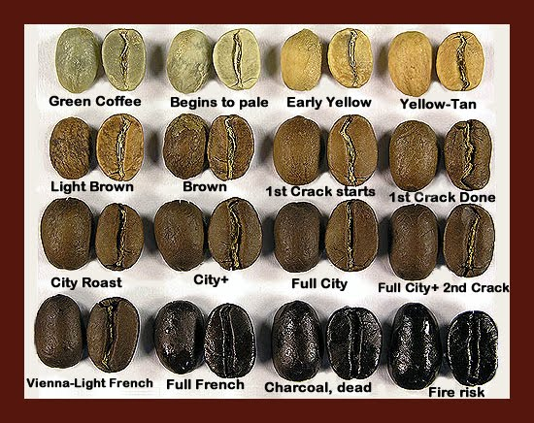
COFFEE BEAN STYLES

Slide 11
LOADBILITY & PRICING
GREEN COFFEE BEANS
60 KGS X 320 BAGS=19,200 KGS FITS IN 1X20 CONTAINER
PRICES DEPENDS ON THE GRADES WHICH WE ARE EXPORTING
ROASTED COFFEE BEANS
25 KGS X 520 BAGS=13,000 KGS FITS IN 1X20 CONTAINER
PRICES DEPENDS ON THE BLENDS WHICH BUYER REQUIREMENTS
SPRAY DRIED INSTANT COFFEE
25 KGS X 540 CARTONS=13,500 KGS FITS IN 1X40 HIGH CUBE CONTAINERS
PRICES DEPENDS ON THE GRADES WHICH WE ARE EXPORTING TO CUSTOMER
AGGLOMERATED INSTANT COFFEE
22 KGS X 545 CARTONS = 11,990 KGS FITS IN 1X40 HIGH CUBE CONTAINERS
PRICES DEPENDS ON THE GRADES WHICH WE ARE EXPORTING TO CUSTOMER
FREEZE DRIED INSTANT COFFEE
22 KGS X 545 CARTONS = 11,990 KGS FITS IN 1X40 HIGH CUBE CONTAINERS
PRICES DEPENDS ON THE GRADES WHICH WE ARE EXPORTING TO CUSTOMER

Slide 12
MARKET
USA
EUROPE
RUSSIA
TURKEY
EGYPT
GCC COUNTRIES
AFRICAN COUNTRIES
SYRIA
EAST ASIA
AUSTRLIA
NEW ZELAND

